Slide 1
CNN accelerator system for recognition of Echocardiographic Images
bowling

Slide 2


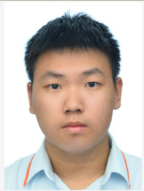
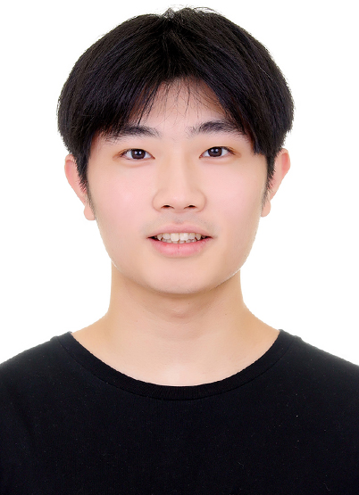
Member
李柏寬
章劉軒瑋
葉仲勛

Slide 3
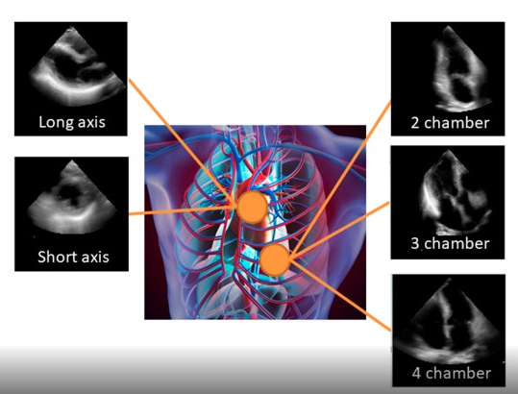
Motivation and Data
Motivation
We aim to train a model capable of quickly recognizing visual data from different perspectives, assisting doctors in making diagnoses.
Data set
Echocardiographic images
Train: 4000
Validation: 500
Test: 500
Classes: 5
Image size:120 x 120 pixels

Slide 4
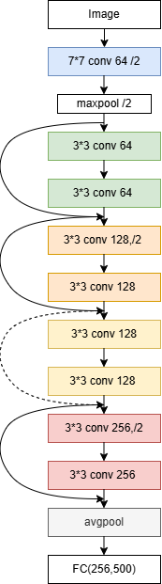
Software
Layer | output | Filter size | Number of filter
Conv (7x7) | 60 x 60 x 64 | 7x7 / 2 / 3 | 64
Max Pooling | 30 x 30 x 64 | 3x3 / 2 / 1
Conv (3x3) Block 1 | 30 x 30 x 64 | 3x3 / 1 / 1 | 64
Conv (3x3) Block 1 | 30 x 30 x 64 | 3x3 / 1 / 1 | 64
Conv (3x3) Block 2 | 15 x 15 x 128 | 3x3 / 1 / 1 | 128
Conv (3x3) Block 3 | 15 x 15 x 128 | 3x3 / 1 / 1 | 128
Conv (3x3) Block 3 | 8 x 8 x 256 | 3x3 / 2 / 1 | 256
Conv (3x3) Block 4 | 8 x 8 x 256 | 3x3 / 1 / 1 | 256
Avg Pooling | 1 x 1 x 256 | - | -
Fully Connected | 500 | - | 500
Pytorch for CNN
ResNet
Convolution
Pooling
Fully connected
Shortcut Connections
Parameter = 1301772

Slide 5
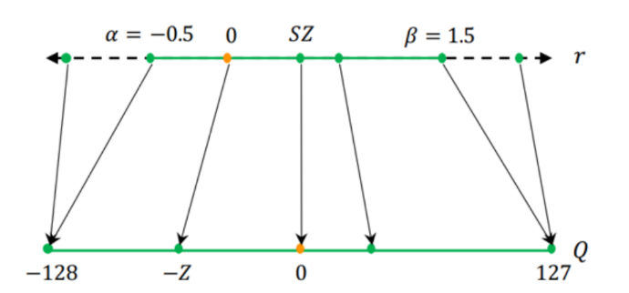
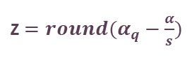


Quantization
Map the original values to an integer range of -128 to 127
Implement quantization using scale factor and zero point.
$$q=round\left(\frac{r}{s}+Z\right)$$
where
s$= \frac{β−α}{β_{q}−α_{q}}$
Z$=round(α_{q}−\frac{α}{s})$
Notes:
浮點數被映射到某個整數範圍，例如 -128 到 127。
這種映射通常基於一個scale factor，將浮點數值除以scale factor後四捨五入，使其落入整數範圍內。
對稱量化的優點是實現簡單，適合大多數 CNN 模型的權重和激活值。

Slide 6
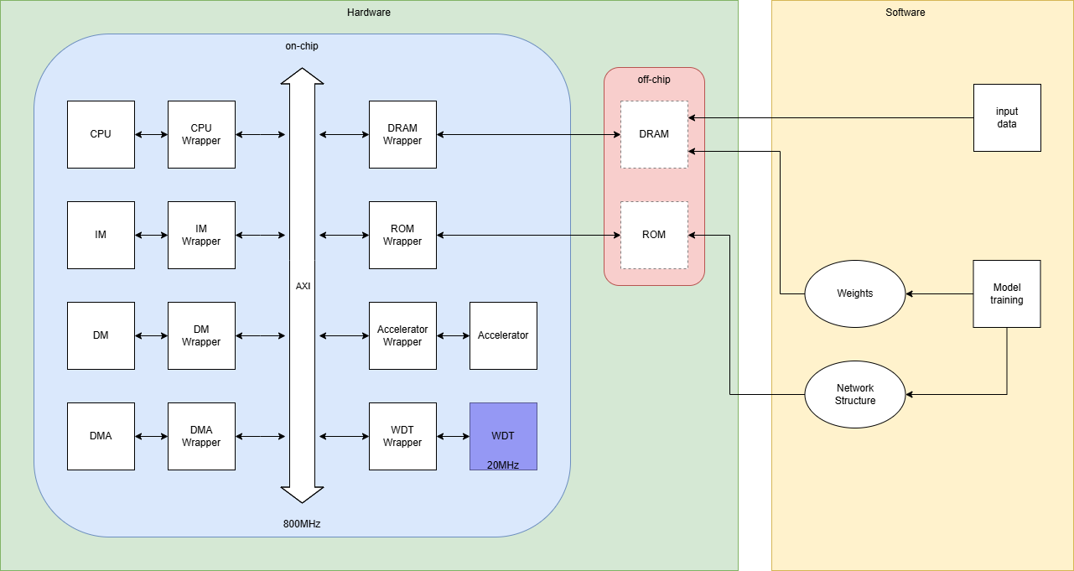
System Overview
32 bits AXI data width (800MHz)
AI accelerator (at least 100MHz)
32bits RISC-V CPU (800MHz)

Slide 7
CPU & Accelerator
CPU send trigger to Accelerator & DMA
CPU
DMA
DRAM
Control signal
Data
Accelerator

Slide 8
CPU & Accelerator
Accelerator receiving data and doing calculation
CPU
DMA
DRAM
Control signal
Data
Accelerator

Slide 9
CPU & Accelerator
Accelerator saved results and send interrupt to CPU
CPU
DMA
DRAM
Control signal
Data
Accelerator

Slide 10
DMA
DMA
DMA register
● Offloads the CPU
- DMA takes over these data transfer tasks, allowing the CPU to focus on control and coordination
tasks without being burdened by memory operations.
● Accelerates Data Transfer
- DMA enables fast and direct data transfers between external memory and on-chip SRAMs, ensuring
that the accelerator's compute units are not idle waiting for data.
● Reduces Latency and Bandwidth Bottlenecks
- By managing data movement directly, DMA can optimize data paths and minimize latency, it helps
reduce the impact of transmission bandwidth limitations.
● Supports Continuous Data Flow
- Preload data into input buffers while computation is ongoing, which can maintain a continuous
data flow enhancing overall throughput and reducing idle time in the processing pipeline.

Slide 11
Accelerator Overview
AXI bus
Edge Computing Purpose Accelerator:
Convolution Unit
Input
SRAM
Input Buffer
D
R
A
M
● Depthwise-Separable Convolution
● Performance Expectations
- Target frequency: at least 100 MHz
- Optimized for inference tasks only
● Compute array
- Utilizes a 16x16 processing systolic
array
● prefer to use 64-bits bus and
SRAMs
- Accelerate by DMA
. . . .
DMA
. . . .
Weight
SRAM
Weight
Buffer
.
.
.
.
.
.
.
.
.
.
.
.
. . . .
Output
SRAM
Output Buffer

Slide 12
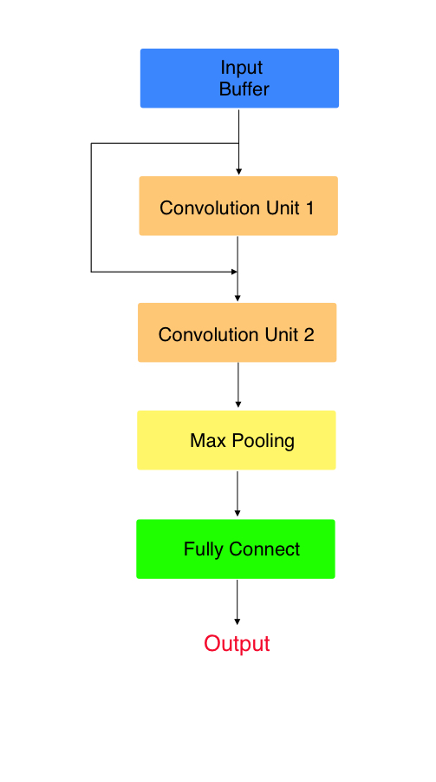

Accelerator
講者：葉仲勛
Input Buffer
Pooling Unit
Max Pooling
Retain the most salient features while reducing data dimensions.
Fully Connect
Y = W * X + b
Responsible for generating the final classification result.
Skip Connection
Notes:
Max Pooling:保留特徵，減少數據維度
Fully Connect:將特徵綜合起來，並產生最終的分類結果。
使用跳躍連接（Skip Connection）將輸入直接傳遞到後面的層，減少了梯度消失的問題，允許訓練更深層的網絡。

Slide 13
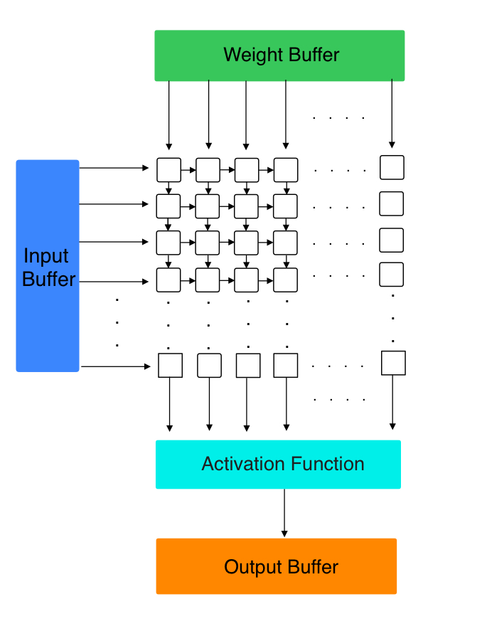
Convolution Unit
MAC Units
16 x 16 systolic array
256 PE
Input Buffer
Activation Function Unit
ReLU activation function
Output Buffer
Clock rate
800MHz
Throughput
204.8 GOPS
PE
Notes:
Systolic Array 通過資料在處理單元之間的固定流動模式，每個 PE 能夠在不同的時刻執行不同的計算，在陣列內部進行並行處理

Slide 14
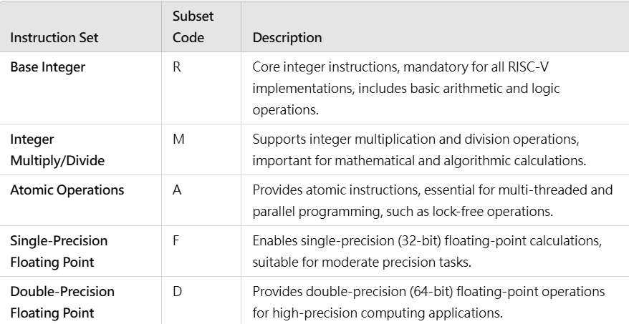
RISC-V CPU
Types of instruction
M - Integer Multiplication and Division
F - Single Precision Floating Point
D - Double Precision Floating Point
V - Vector Operations
Specification
Clock Rate：800 MHz
Bit Width：32 bits
Pipeline ： 5 stages
Cores ： 1 cores
Notes:
數據送至 AI 加速器之前，CPU 需要進行一些數據預處理，如數據增強
向量指令可以幫助 CPU 更高效地在本地處理這些較小、較分散的任務，而不必花時間將數據傳輸至加速器並等待處理結果

Slide 15
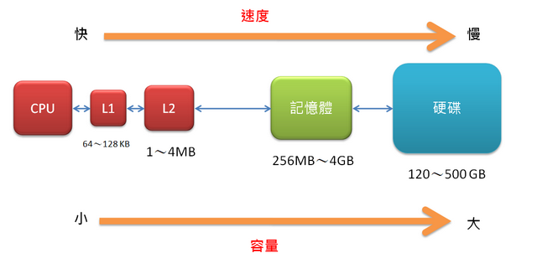
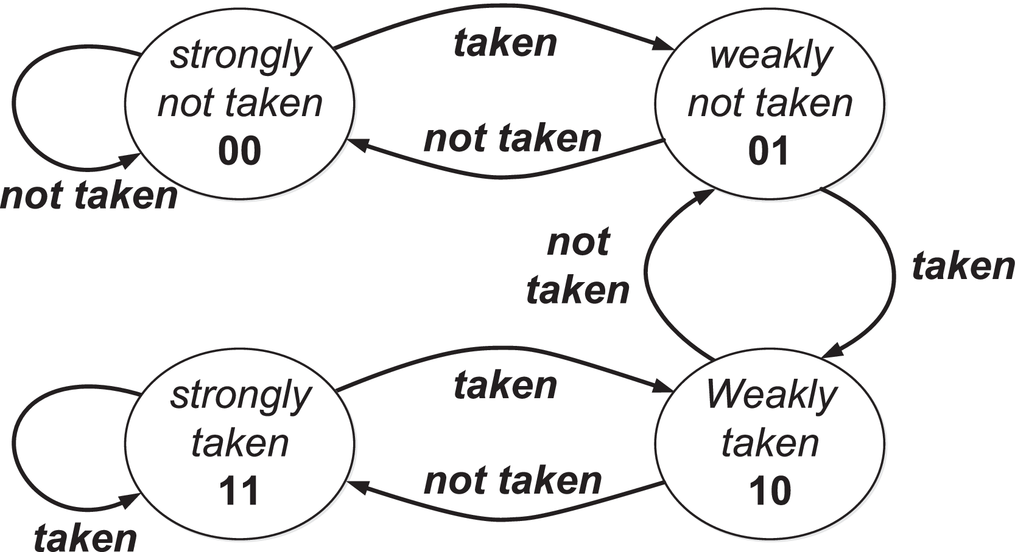
CPU Performance Speed Up
Cache
store frequently accessed data
L1 : 64KB
L2 : 1MB
Dynamic Branch Prediction
predicts the likely outcome of conditional instructions
Add control signal in PC_reg to predict Branch
2-bit branch predictor
penalty: 2 cycles
Notes:
Cache：加速數據存取速度
Branch Prediction (動態預測分之)：根據指令歷史來做出預測，可以降低分支錯誤帶來的性能損失。

Slide 16
Task assignments
施柏安：testbench. 林弘偉：CPU, AXI. 葉仲勛：DMA, memory. 李柏寬：AI accelerator. 章劉軒瑋：Soft-ware design.

Slide 17
schedule

Slide 18
Thanks for Listening

